Slide 1

Perfecting the Family Court
… and what’s even better
Law and Justice Advisory Board
Two Wishes Foundation
WORLD CONGRESS ON FAMILY LAW & CHILDREN'S RIGHTS
CAMBRIDGE, UK, JULY 2025

Slide 2
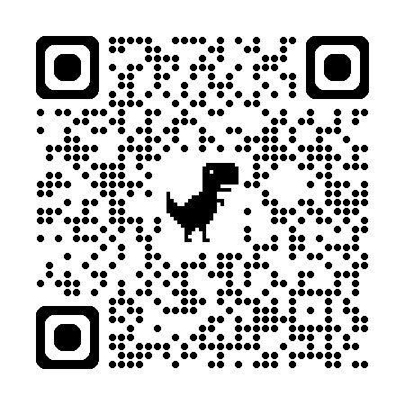

Two Wishes Foundation
Two Wishes is an international foundation dedicated to transforming how the world views and deals with parental separation and family breakdown.
Its vision and mission have been driven by the voices of young people who’ve experienced the systems of yesterday – children who missed out on their First Wish, to grow up in a healthy, happy family.
twowishesfoundation.org.uk
Notes:
In the words of one young person, Rosy:
“I used to think that every child got three wishes. But my very first wish – to grow up in a happy family – did not come true.
My second wish was to spend as much time as possible with each of my parents and everyone who loved and cared for me. That didn’t come true either.
My third wish, I’m determined, will come true: to make sure that what happened to me – a childhood lost in systems meant to help me – will never happen to any other child.”
The Two Wishes Vision is of a world where all children have positive relationships with all who love and care for them, whatever shape their family takes.
The Foundation is raising awareness internationally of the urgent need for a fresh approach to family separation and for the development of innovative policies and practices that provide compassionate, earlier support for all families.

Slide 3

Law and Justice Advisory Board
3
Role
Reviewing existing systems
Finding and promoting world’s best practices
Advocating improvements to current systems
Proposing better systems
There is a consensus that there is a need for a paradigm shift in the way societies and families regard parental separation, and on how to reach arrangements for children without exposing them to avoidable harm.
Notes:
An important part of the work of the Two Wishes Foundation is reviewing existing systems and, where they do not contribute to the wellbeing of children whose parents separate and divorce, and especially when they detract from the child's healthy development, to propose better systems.
The TWO WISHES LAW AND JUSTICE ADVISORY BOARD, whose members are eight judges, some retired and some who are serving, from Family Courts on five continents, has studied and reviewed the ways in which countries and their court systems approach situations in which parents separate, the effects on children, and how to prevent, or at least minimize, harm.
There is a consensus that there is a need for a paradigm shift in the way societies and families regard parental separation, and how to reach arrangements for the children without exposing them to needless harm.

Slide 4
Law and Justice Advisory Board
4
Current members
(in alphabetical order):
Portugal: Judge José Barros
Belgium: Judge Marie-France Carlier (co-chair)
USA: Judge (retired) Bruce Cohen
India: Judge (retired) Roshan Dalvi
Japan: Judge (retired) Daisuke Ikuta
Israel: Judge (retired) Philip Marcus (co-chair)
South Africa: Magistrate (retired) Gabriela McKellar
Argentina: Judge (retired) Mauricio Mizrahi
with assistance from:
Scotland: Dr Nick Child, UK Board Member & Child Psychiatrist
and Family Therapist (retired)
Australia: Dr David Curl, Australia & UK Board Member, Two Wishes Foundation
The views expressed by individual members in this presentation do not necessarily represent
the views of their own institutions, the policy of Two Wishes, or the views of other members.

Slide 5

Law and Justice Advisory Board
5
Our work so far
After meeting many times, consulting with colleagues from around the world, and reviewing the literature, we have reached a consensus on many issues. Our initial findings and recommendations can be found in our report – along with a summary of today’s presentations – accessible via this QR code:
“Perfecting the Family Court
… and what’s even better:
Report and recommendations for
minimizing harm to children
whose parents separate.”

Slide 6
6
Report and Recommendations
Part One: What is better than court?
Helping parents to decide on arrangements
for their children without the family court!

Slide 7
7
Children have enough to cope with
when their parents separate
Loss of stability – from one home to two
Parents are stressed and preoccupied with their own feelings
Sadness, concerns about the future
Loyalty issues
etc.

Slide 8
8
Adversarial court proceedings
make it worse for children
Loss of stability – from one home to two
Parents competing, each trying to be victorious over the other
Child internalizes conflictual thinking, loses faith in permanence of relationships
Parent’s legal expenses diminish resources available for the children
Inadequate or harmful coping mechanisms
Increased risk of mental and physical health problems
etc.

Slide 9
9
Report and Recommendations
Part Two: How to make courts better?
Moving away from adversarial adjudications
towards child-centered, multidisciplinary, therapeutic resolutions!

Slide 10
10
How to make courts better
Specialist Judges, and Training for Judges, Lawyers and Court Staff
Judicial Continuity: One Family – One File – One Judge
Information and Guidance for Parents Entering the Family Court:
Diversion Away from Litigation
Triage in the Family Court
Swift Handling by the Court

Slide 11
11
How to make courts better
Multidisciplinary Family Courts
Child Involvement
Expert Evidence
Enforcement: Clear Orders and Appropriate Sanctions for Breach
Accountability: Record Keeping, Follow Up, Quality Control

Slide 12
BRINGING ABOUT CHANGE IN ESTABLISHED SYSTEMS
Judge Bruce R. Cohen (ret.)
Maricopa County Superior Court
State of Arizona, USA

Slide 13

The wisdom of the adversarial process?

Slide 14

Assume there is a new society. In that society, they recognize that two people will want to create a formal relationship---marriage. Assume further that as a result of that formalized relationship, they may have children.
That society would understand that some of those marriages would come to an end and, when they do, a process would be needed by which those formalized relationships as spouses would end, while their relationship as parents would be preserved.
So, the new society convened a conference of the great thinkers of the time to develop the system necessary to preserve the best interests of the children.
Law and Justice Advisory Board, Two Wishes Foundation, 2025

Slide 15
Who believes that the society would conclude that the best process to address the future of the children would be the adversarial process?
Law and Justice Advisory Board, Two Wishes Foundation, 2025

Slide 16


Best Interests?
Ask the right question
The adversarial process
The new paradigm
Law and Justice Advisory Board, Two Wishes Foundation, 2025

Slide 17

Law and Justice Advisory Board, Two Wishes Foundation, 2025

Slide 18
The starting point
Do | grow up to | Mother | father
YOU | Be Happy
WANT | BE Healthy
YOUR | Be Well-Adjusted
CHILD | Be Prepared for life
TO: | WANT YOU Involved
Law and Justice Advisory Board, Two Wishes Foundation, 2025

Slide 19


The starting point
Do | grow up to | Mother | father
YOU | Be Happy
WANT | BE Healthy
YOUR | Be Well-Adjusted
CHILD | Be Prepared for life
TO: | WANT YOU Involved
Law and Justice Advisory Board, Two Wishes Foundation, 2025

Slide 20
What Is Better Than Court?
Upstream, not downstream
We spend untold effort, time and resources, to rescue the person who falls into the river from the unfenced bridge, and on resuscitation and rehabilitation, when it would be safer, easier and cheaper to build a parapet on the bridge to stop him falling in.
With gratitude to Dr Nick Child
What is better than court?
Helping parents to decide on arrangements for their children,
without the family court!
Law and Justice Advisory Board, Two Wishes Foundation, 2025

Slide 21
Going to court only when there is no alternative
Society has a compelling interest in reducing to a minimum the use of the services of the court system, which are highly expensive in terms of resources and almost always overwhelmed given staffing shortages.
In most legal systems, courts exist to deal with legal disputes, but in a majority of situations when couples separate, there are no legal issues involved, and they do not need to be dealt with by the court.
Law and Justice Advisory Board, Two Wishes Foundation, 2025

Slide 22
Parental Responsibilities:
Cooperation, not Conflict
Parents must take responsibility for preserving their child’s relationship with both parents and should be helped to focus on the needs of the child.
“Where there are no issues of domestic abuse or child protection, parents ought to be able, or encouraged, to make arrangements for their own child, rather than come to a court of law and a judge to resolve the issues."
Sir Andrew McFarlane
Law and Justice Advisory Board, Two Wishes Foundation, 2025

Slide 23
The harmful misconception
When parents separate, they often focus on their own pain—blame, anger, fear—while overlooking the grief and loss their children experience. Influenced by media portrayals, many believe court is the first step.
But this is a harmful misconception.
The real starting point should be addressing children’s emotional needs. Parents must take responsibility for preserving their child’s relationship with both parents, and should focus on cooperation—not conflict—as the foundation for moving forward.
Law and Justice Advisory Board, Two Wishes Foundation, 2025

Slide 24
Non-legal services: make them accessible and incentivize their use
The filing of documents in court inevitably places the parties in an adversarial frame of mind, thereby undermining the likelihood of reaching agreements relating to the needs of their children.
Couples who are separating should be made aware that there are many non-legal services that can help non-legal services who can move them, in a non-confrontational way, toward agreement about the arrangements for the children post-separation.
Law and Justice Advisory Board, Two Wishes Foundation, 2025

Slide 25
Where to go: qualified professionals
Couples counselling
Consultation with child development specialists
Conciliation and mediation services
Collaborative practice
Help from church and social organizations
etc.
Accessible – local community centres, libraries
Affordable – subsidies
Law and Justice Advisory Board, Two Wishes Foundation, 2025

Slide 26
Incentives
Legal Aid for free consultation with a lawyer – for those who cannot afford it, who can identify whether there are legal issues. Otherwise, poor parents think that they have no alternative to applying to the court.
Attendance at relationship centres, and exploration of possible ADR, as a condition for applying to court
Vouchers for payment to mediators
Law and Justice Advisory Board, Two Wishes Foundation, 2025

Slide 27
Holding a Mirror Up to the Court Process to Reduce Parental Conflict
Court systems in some places operate reasonably well, while others urgently need improvement.
We believe that family courts need to be better integrated into a more holistic system that treats family separation primarily as a health and relationship issue and puts greater emphasis and resources into earlier interventions and education.
We advocate for the incorporation of proven child protective features into family courts throughout the world, subject to local cultural differences.
Law and Justice Advisory Board, Two Wishes Foundation, 2025

Slide 28
The FIT Program: a new approach to addressing high conflict parenting cases
Judge Bruce R. Cohen (ret.)
Maricopa County Superior Court
State of Arizona, USA
Law and Justice Advisory Board, Two Wishes Foundation, 2025

Slide 29
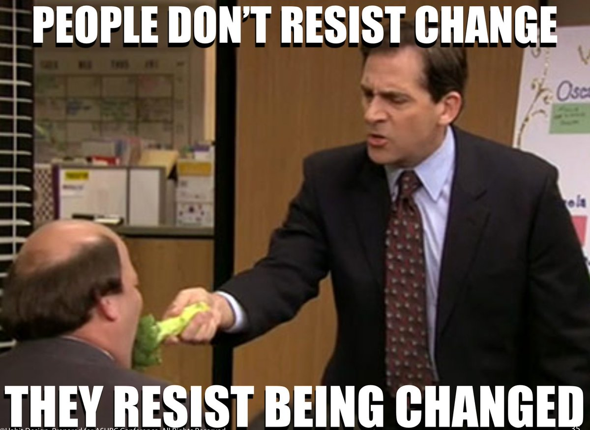
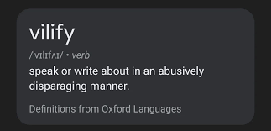
How do we deal with parents engaged in high conflict parenting approaches?
Law and Justice Advisory Board, Two Wishes Foundation, 2025

Slide 30

FIT PROGRAM
Law and Justice Advisory Board, Two Wishes Foundation, 2025

Slide 31




The Four Modules of FIT
Validation
Impact on Children
New Vision
Implementing the New Vision

Slide 32

Validation doesn’t necessarily mean that you agree with someone’s thoughts or behaviors it means that you recognize their feelings

Slide 33
FIT WORKS!
2023 Pilot Program
Maricopa County Superior Court, Arizona
In concert with Arizona State University
Compared FIT to existing in-house gold standard 4-hour program called “Parental Conflict Resolution Program.”
Found that unlike the existing PCR program, FIT reduced reported parental conflict to a statistically significant degree.
Follow-up study
Tracked the same families who went through pilot program in 2023 to determine longer term impact on litigation.
Found that unlike the existing PCR program, FIT reduced post-intervention initiation of litigation to a statistically significant degree and had a statistically significant increase in settlements for any post-intervention new filings (modification or enforcement)

Slide 34
For more information: judgebrucecohen@gmail.com
Thank You!
Law and Justice Advisory Board, Two Wishes Foundation, 2025

Slide 35

Specialist Judges and Training
You have a great family doctor, and a wonderful orthopedist. But would you want either of them to perform brain surgery on your child?
Mrs. Justice Roshan Dalvi
Former Judge, Bombay High Court, INDIA

Slide 36









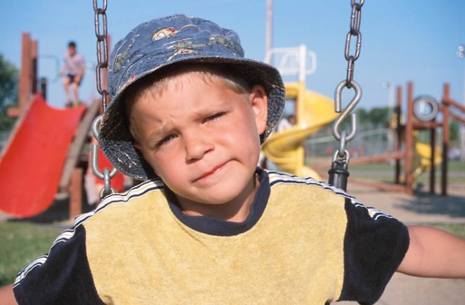







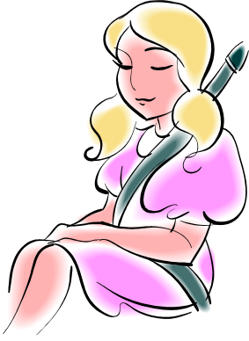



Slide 37
Information and guidance for parents entering the family court: diversion away from litigation
Marie-France Carlier- DAISUKE IKuta –gabriela Mckellar

Slide 38

Non-adversial processes aimed at reaching agreements between parents on arrangements for their children
In some places, statutory framework mandating attendance by parents at meetings relating to the needs of the children and explaining the ADR
Judges: experience and skills necessary to convince the parents to take the good track of a non-adversial solution

Slide 39
Cochem Model
Origin of the approach:
Findings made by Judge RUDOLF
"Win-lose" philosophy
Parents become adversaries
Children always losing
Length and slowness of the procedure
Aggressive Writing
Stigmatizing expert reports
Escalating the conflict

Slide 40
Cochem Model or Practice:
Orderly cooperation system:
interdisciplinary and rapid management of a separation
in which the parents are empowered to reach an agreement for the child’s
well-being
Main axes:
- Interdisciplinarity
- Rapid response
- Accountability of parents for the child's interests

Slide 41

Cochem to Dinant

Slide 42
Adaptation of the model to the Belgian procedure
      Guidelines
    A procedure at the service of the litigants, and not the litigants at the service of a procedure
    Limitation of writings to the strict minimum
    Fast and efficient care
    Accountability of parents for the child's interests
    Professional intervention should not make parents adversarial or increase conflict
    Interdisciplinary vision of situations

Slide 43
The procedure and tools
Simplified application (questions in boxes to be ticked – brief reasons)
1st hearing: 3 weeks later (avoiding loss of ties in conflict situations):
Writings limited to the strict minimum: verba volant, scripta manent
2 sample agreements available to lawyers and parents to fill in before the hearing
Approved or imposed framework from the first hearing:
- Total or partial agreements without dialogue: provisional homologation + mediation or
communication workshops for separated parents or Chamber of Amicable Settlements (CRA)
- No agreements: provisional framework + mediation or communication workshops or CRA
- If ties are broken: collaborative expertise

Slide 44
Role of the family judge
Mission to conciliate and promote ADR
“Art. 730/1. § 1. of the Judicial Code: “The judge shall at any stage of the proceedings favour a method of amicable resolution of disputes”
Interdisciplinary work from the first hearing with the help of the procedure (personal appearance, Article 1253ter/1 §2)
Continually refocus the parties on the best interests of their child
Interactive meeting to understand family dynamics and propose tools adapted to the problem
Reasons for judgments: inviting the parties to trust each other again

Slide 45
The secret to successful collaboration:
The multidisciplinary commission
ass
ddddddd
Composition (judges, magistrates, lawyers, mediators, experts, SAJ, SPJ, Maison de Justice, Contact Centres, Family Planning, etc.):
no hierarchy
Implemented in December 2012
Monthly meetings for the first few years and then quarterly
Presentation of the professions and existing initiatives in the area
Discussions on the desired improvements, the problems encountered (the link between civil and protection, etc.)
Organization of conferences and symposia
Invitation of foreign experts such as Lorraine Fillion at the origin of communication workshops for separated parents
xxxxxxxxxxxxx
oo

Slide 46
DIVERSION IN THE SOUTH AFRICAN CHILDREN’S COURT
Law and Justice Advisory Group, Two Wishes Foundation, 2025

Slide 47
Constitution Section 28(2)
A child’s best interests are of paramount importance in every matter concerning the child.

Slide 48
The Children’s Act 38 of 2005 promotes conciliation and problem-solving and discourages a confrontational approach and any delays

Slide 49
parenting plans mediation family group conferencing lay forums

Slide 50
Office of the Family Advocate
Social Workers
Pro bono mediators

Slide 51
The court’s role is primarily to solve the child’s problem.

Slide 52
The Act requires that the voice of the child be heard.

Slide 53
Problem-Solving Court
Not
Winner/loser or
Guilty/innocent.

Slide 54
The Act compels that the proceedings take place in a child-friendly environment.

Slide 55
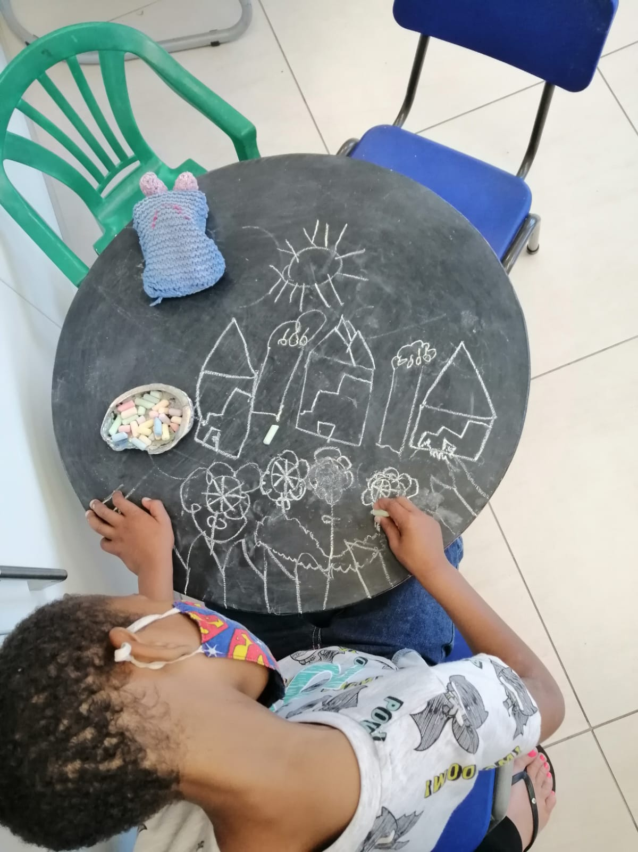

Slide 56
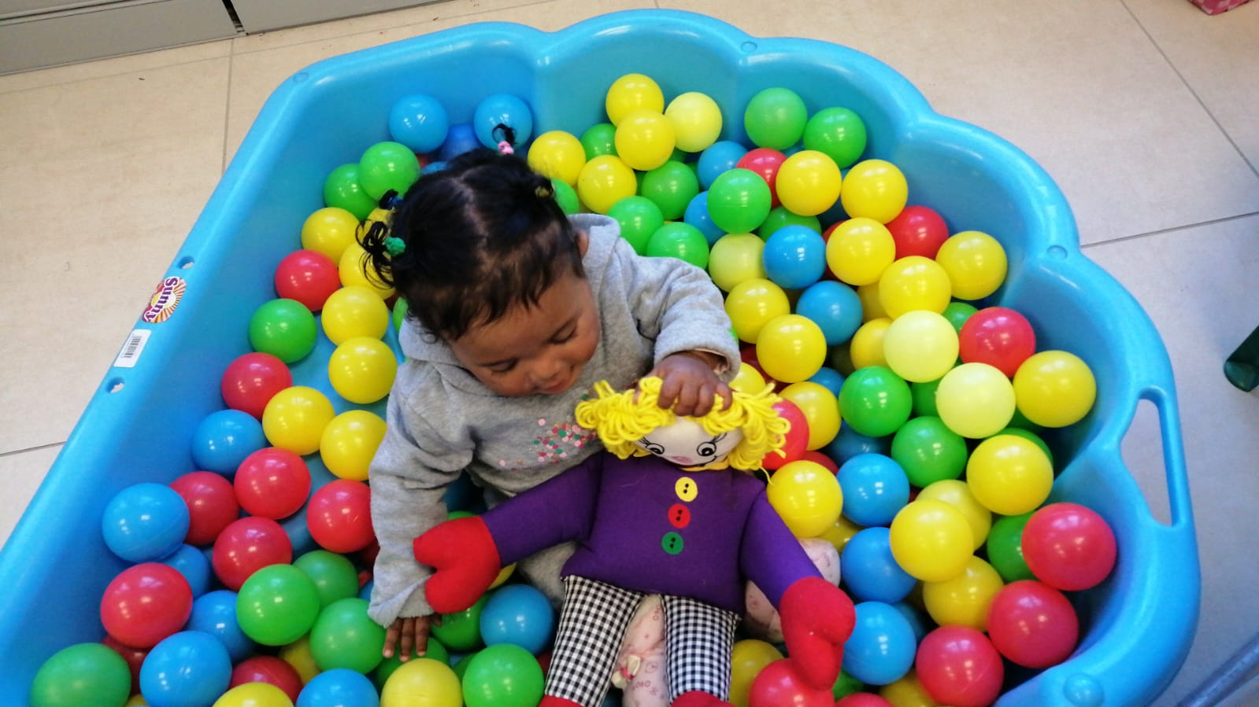

Slide 57
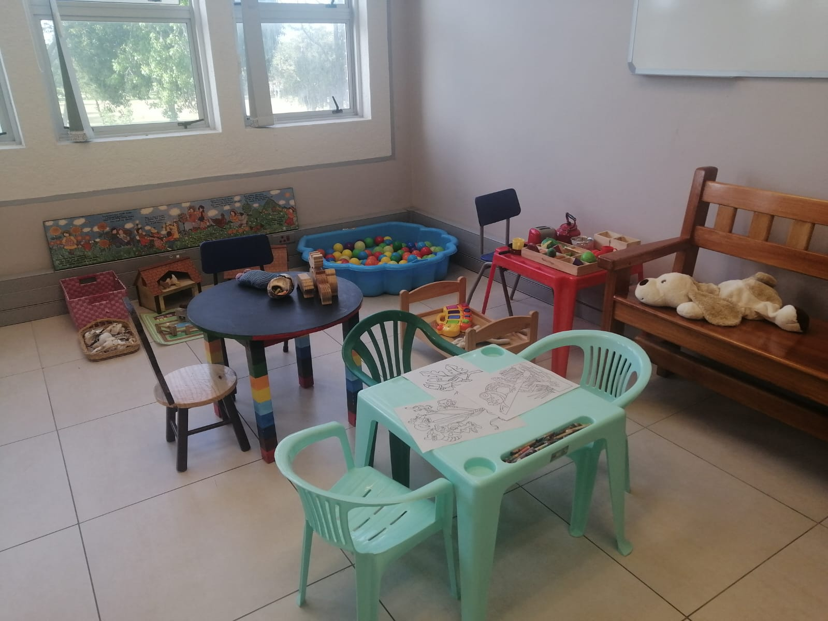

Slide 58
1. High Court
2. Divorce Court
3. Children's Court
4. Domestic Violence Court
5. Maintenance Court

Slide 59
Judges and magistrates compel an attempt to mediate.

Slide 60
Constitution Section 28(2)
A child’s best interests are of paramount importance in every matter concerning the child.

Slide 61

The Japanese Experience of In-Court Mediation
Judge (retired)
Daisuke IKUTA
Japan

Slide 62
Triage in the Family Court: Why?
Inappropriate handling of cases involving children at the initial stages causes serious and long-lasting harm.
Errors may lead to irreparable psychological, emotional, and social damage to children and members of the families of the litigant.
Faulty handling of the case at its outset can cause economic costs and unnecessary pressure on scarce resources of manpower, necessitated by the need to try to put right what went wrong.

Slide 63
Triage in the Family Court: How?
Assess, as soon as the file is opened in the court secretariat:
Whether the matter needs urgent attention
What is the level of urgency
Who is the most appropriate person to give assistance
Which procedures should be used
All these against the background of limited resources, time and manpower.
Law and Justice Advisory Board, Two Wishes Foundation, 2025

Slide 64
Some cases need immediate social work help, but not necessarily judicial intervention
Most cases require help in resolving relationship problems.
Many of these cases do not need a judicial adjudication.
So, the trieur should be able to call on social workers for intake, assessment and advice for the parents.
Law and Justice Advisory Board, Two Wishes Foundation, 2025

Slide 65
Is it really urgent?
Not all applications marked “urgent” are in fact urgent
Some “regular” applications are in fact urgent, especially where child-parent contact issues are concerned
For example, abduction and relocation applications need immediate intervention to prevent reliance on time lapse fait accompli
So, a trained trieur should review each application
Law and Justice Advisory Board, Two Wishes Foundation, 2025

Slide 66
Urgency
Some types of case have statutory timeframes, e.g.:
Immediate ex parte hearing of DV injunction applications, with inter partes hearing within 7 days;
First hearing of applications alleging child abuse or contact interference within 14 days of filing;
Hague abduction applications – decision within 6 weeks.
Law and Justice Advisory Board, Two Wishes Foundation, 2025

Slide 67
Levels of urgency
Immediate (court order required this day,
ex parte, to prevent injury/deterioration/ abduction);
Next day (with expedited service on other party);
Within 7 days;
Within 14 days;
Not urgent.
Law and Justice Advisory Board, Two Wishes Foundation, 2025

Slide 68
Swift handling by the court
Fast, but not furious
The longer a child is exposed to tension and stress, the more likely it is that he will suffer ongoing, and even lifetime, psychological harm;
A child's perception of time is very different from that of an adult.
VJ Felitti, RF Anda, D Nordenberg, et al, ‘Relationship of childhood abuse and household dysfunction to many of the leading causes of death in adults: the Adverse Childhood Experiences (ACE) Study’ (1998) 14(4) Am J Prev Med 245 1998;14(4):245-258 <doi:10. 1016/S0749-3797(98)00017-8>.
Law and Justice Advisory Board, Two Wishes Foundation, 2025

Slide 69
The Court has a Duty to Exercise Exceptional Diligence
The European Court of Human Rights, in a case involving contact between a mother and her children, said this:
"In cases concerning a person’s relationship with his or her child, there is a duty to exercise exceptional diligence, in view of the risk that the passage of time may result in a de facto determination of the matter.”
Pisica v Moldova (Application No 23641/17) 29 October 2019, at para 66.

Slide 70
Multiple Judges, Multiple Hearings
Re T (A Child) (s 9(6) Children Act 1989 orders: Exceptional Circumstances: Parental Alienation): ten years, 70 hearings, 26 judges [2024] EWHC 59 (Fam)
London Borough of Enfield v E (Unconscionable Delay): two years, nine different judges over seventeen hearings involving thirty-three different advocates.[2024] EWFC 183
Such examples are unacceptable.

Slide 71
Pathfinder Pilot
"Rather than being litigant led, with the court only gaining some independent account of the issues and of the child’s wishes and feelings some many months into the proceedings, no hearing is held in a Pathfinder court until CAFCASS or Cafcass Cymru have filed a full ‘Child Impact Report’. This means that at the first hearing the court has a good deal of information, including, importantly, the voice of the child so that that hearing is very much focused on ‘what are we going to do about this to make things better for your child’, rather than on ‘what is your dispute about?”
Sir Andrew McFarlane
View from the President’s Chambers
April 2025

Slide 72
Achievements of Pathfinder
“In North Wales, the average number of weeks from application to final order has reduced from 29 weeks in 2022 to 18 weeks in 2024. The number of open cases has reduced from 478 to 202 over that period. In Dorset the average number of weeks from application to final order reduced from 38 weeks to 27 weeks during the same period. The number of open cases has fallen from 511 to 246.”
Pathfinder Pilot Management Information, February 2025
This is remarkable.

Slide 73
Judicial continuity : One family - One judge
One judge - One child
Marie-France CARLIER - Family and Youth judge
in Belgium

Slide 74

In many jurisdictions : different courts or judges according to subject matters
In other countries, family proceedings at any of several levels. In England and Wales, the Family Court has 3 parts.

Slide 75
Family Courts LaW of 1995 in ISRAEL
Fixed as Guiding principle :
One FAMILY-one judge
  allows the judge to identify all the relationships, the alliances
  within the family and to know better the personalities of the parents
  Makes it easier to observe personality disorders or manipulations

Slide 76

Family court law of July 31 2013 in Belgium
Guiding principle : all legal matters concerning a family under the responsibilty of a single judge based on the concept :
ONE FAMILY-ONE FILE-ONE JUDGE
prevents parties from having to repeatedly explain the background of the case
promotES procedural EFFICIENCY
ensureS consistency between successive decisionS
enableS the judge to become familiar WITH the parents and sometimes also the children

Slide 77
UnIQUENESS of the family file
Each family will have
a single, opened file
that will be unique
The term « Family » refers to married couples, legal cohabitants or partners along with their children

Slide 78
UNIQUENESS of The JUDGE
Does apply to the same individual judge
Main advantage: to prevent “gambling”
Impartial judge does not mean that the judge must be restricted to a single function
Not contrary to the principle outlined in article 6 of the Convention for the Protection of the Human Rights

Slide 79
«The mere fact that a judge has already made decisions before the trial cannot justify , in itself, apprehensions as to his impartiality.
What matters is the extent of the measures adopted by the judge before the trial... »
MOREL v. France, 6 June 2000

Slide 80
Multidisciplinary Family Courts
An operating theater needs surgeons, doctors who are specialists in the organs or medical conditions involved, anesthetists, nurses, technicians, etc.
A judge cannot handle family matters involving children
without the support of other professionals.
Members of the various professions connected with the family court, who are involved in cases where families need help, to sit together on a regular basis, in order that they can learn together, and from each other, about current developments in each field.
The family court needs to supply legal/judicial and psychosocial services.

Slide 81
A new model of working together in the best interest of children.
Judge José Barros, Portugal

Slide 82
Agenda
The distinctive roles of the Court’s work and of forensic evaluations.
The problems within the current model of forensic evaluations.
Proposal - the inclusion of forensic evaluators in multidisciplinary teams helping Family Courts.

Slide 83
Introduction
Research in attachment theory, childhood adverse experiences, complex PTSD and personality disorders has shown judges that understanding child abuse, domestic violence, parental conflict and parent-child relationship problems relies on more than common sense and demands a more scientific approach.

Slide 84
The distinctive roles of Courts and forensic evaluations
The facts of the case are established by the Court considering all evidence (police reports, clinical documents, witness statements, etc.) brought by the parties and gathered by the Court in evidentiary hearings and trials.
It`s not up to forensic evaluators to assume a quasi-judicial role and establish facts or recommend parenting arrangements.
However, forensic evaluations do help establish part of those facts (for example, detecting signs of abuse in the child) and also help courts understand them (using, for instance, attachment theory to explain the child’s behaviour).

Slide 85
Problems within the current model of forensic evaluations
The New York Blue Ribbon Commission’s decision in 2022 to suspend forensic evaluations and the concerns about their misuse by the Family Courts in cases involving domestic violence.
The problem with forensic evaluations offering a snapshot of the family dynamics and not "the whole movie".
The need for forensic evaluations to maintain a longitudinal view of the case’s and family dynamics history throughout its evolution.

Slide 86
Our Proposal:
The Inclusion of Forensic Evaluators in Multidisciplinary Teams
Forensic evaluators would work in the case longitudinally, meaning, for its whole duration, which would provide them an overview of the whole family history and dynamics (including, of course, former cases involving the same parents and child).
They would have access to all the case files (including old cases involving the same family) and be present in parent meetings in court, as well as at supervised visitation (when it’s going on), and also go together with social workers to the parents’ houses to meet children and parents in their own environment.

Slide 87
Our Proposal:
The Inclusion of Forensic Evaluators in Multidisciplinary Teams
3) With time, the inclusion of forensic evaluators in those multdisciplinary teams for several years would help them specialize in the issues that are more common in Family Courts (child abuse, domestic violence, parental conflict and parent–child relationship problems).
4) Inclusion would enable forensic evaluators, social workers, judges, prosecutors and lawyers to exchange knowledge and experience making the "law experts" (judges, prosecutors and lawyers) more knowledgeable in psychology and vice-versa.

Slide 88
Our Proposal:
The Inclusion of Forensic Evaluators in Multidisciplinary Teams
5) The inclusion of forensic evaluators in those multidisciplinary teams would enable protocols and guidelines to be established by their professional boards in a similar way to what happens with social workers, who also work within protocols and guidelines established by CPS or CAFCASS and other similar entities.
6) Forensic evaluators, as happens with social workers, would be paid by the state, be subjected to the same rules of impartiality and remain neutral in their assessments throughout the case’s history.

Slide 89
Conclusion
The use of forensic evaluations is generally useful in family cases and prohibiting its use runs the risk of endangering children more.
What should be discussed is whether the model in which those evaluations are done is the best way to help the court in determining the child’s best interests.
We think our proposal presents several advantages and strongly reduces the risks of mistakes allowing for a more fruitful cooperation between psychology and law in Family Courts.
Thank You!

Slide 90
Child Involvement
Listen to me! A voice, but not a choice.
Article 12, UN Convention on the Rights of the Child:
States Parties shall assure to the child who is capable of forming his or her own views the right to express those views freely in all matters affecting the child, the views of the child being given due weight in accordance with the age and maturity of the child.

Slide 91
Level and Degree of Involvement
Maturity, not chronological age
Vulnerability
Authenticity
With the parents or separately (social worker or advocate present)
Who speaks to the child?
  Social worker, Psychologist, Judge, any combination
Who speaks for the child?
Lawyer. as advocate for the child or for best interests
Guardian ad litem
Parent

Slide 92
Benefits of child involvement
Child can express his/her own understanding of relationships
Opportunity to explain the court process and roles of the judge
Seeing the child at the centre
Explaining the decision, including judge’s letter

Slide 93
What to be alert to:
Judge Mauricio Mizrahi, Argentina

Slide 94
Experts in Family Courts
When do we need experts?
How to choose experts
How to appoint experts
Considering the expert’s report

Slide 95
When do we need experts?
There should be no assumption that a party to litigation is entitled to file the opinion or report of an expert on any issue, or to require that an order should be given appointing an expert.
An expert may be needed to assist the court on these matters:
to give an opinion as to matters of mental health relating to the parents and the children; also the effects of such matters on the parent-child relationship and fulfilment of parental responsibilities;
to assess relationships and interactions in the family including the possibility of triangulation of the child;
to give recommendations as to the arrangements for residence and contact between the child and the parents, extended family, etc.

Slide 96
When do we need experts?
to assess issues of the child's safety; this may include recommendations for supervision of face-to-face contact, or contact by electronic means;
to make recommendations on specific issues, such as the child's place of residence
to conduct a therapeutic intervention, so as to relieve stress and repair some situation which adversely affects the child. This may be a matter of urgency, especially where a child is not in contact with one of the parents.

Slide 97
How to choose experts
What are the issues about which the opinion is needed, and which fields of expertise are appropriate?
What knowledge, skills, education, training, and experience required?
Is the individual under consideration appropriate to the specific family (e.g. language and cultural skills)?
Academic degrees and membership of a professional organization are not necessarily predictors of the suitability of a person for the task being set.
Preference for an expert who has clinical experience in dealing with parental disagreements and the effects of parental separation on children, and a forensic, and trauma informed, approach.

Slide 98
How to appoint experts
It is undesirable for the parties and the children to be seen by more than one expert in a specific field.
The court needs to have control over the appointment of the expert, after consulting with the parties and their legal advisers.
Precise questions – not just “parenting capacity” or “child custody evaluation”.
Set a specific date for filing of the opinion, but also set a review date well before the final date for the parties and the evaluator to report on progress.

Slide 99
Considering the expert’s report
The expert's role is that of a witness, not a substitute decisor.
If a party disputes the opinion, that party may submit a list of questions to the expert; if the answers are unsatisfactory to that party, the court may be asked to summon the expert for cross-examination.
An expert may suggest, or the court may suggest, that the expert be appointed therapist for the family.
A new therapist, would have to learn all about the family, establish therapeutic relationships from afresh.

Slide 100
ENFORCEMENT OF COURT ORDERS
Court decisions regarding children are given reflecting the needs of the child.
It follows that anyone who defies such a decision is acting against the child’s best interests and is harming the child.
Breach of the court’s order undermines the court’s authority in the eyes of the child.
So, such orders should be precise.
Consider attaching a penal notice, describing the sanctions which the court may impose for non-compliance, to such orders.

Slide 101
Enforcement: Immediate Action on Allegations of Breach
A child’s perception of time is different from that of adults, so:
Applications arising from allegations of breach must be dealt with immediately.
An allegation of non-compliance should be brought to the attention of the court (or other agency empowered to enforce the order) immediately, and adjudicated, with the imposition and effectuation of sanctions where ordered, in a matter of days.
If there is a finding of breach, penalties must be immediate.

Slide 102
Enforcement by Imposing Sanctions
The sanctions should not be penal and retributive in nature; rather they should be directed to ensure compliance.
The focus should be on the needs of the child, so that the contemnor shall cease his acts or omissions which adversely affect the child.
Sanctions may be adjusted or removed if the contravening person purges the contempt, by showing remorse and undertaking future compliance.
BUT sanctions must be imposed on a party who brings frivolous or untrue allegations of breach of court orders.

Slide 103
Range of Sanctions
Imprisonment – suspended sentence, short sharp shock, rising scale for repeat breaches
Fines – rising scale for repeat breaches
Compensation for wasted time
Reduction of child support
Referring the case for investigation by the child protection
Order for payment the other parent’s legal fees and court costs, and/or to pay the costs of wasted court time to the court treasury.
Requesting that police open an investigation on the basis of the criminal offence of breaching a court order.

Slide 104
Record Keeping,
Follow Up, Quality Control
Accountability ensures proper handling of services given, and avoidance of waste and duplication with its associated waste of resources.
The court and the public need to know if the secretariat and the judges are serving the public properly.
The court needs to know if its decisions in relation to children are helping the child.
The court needs to know if the decisions are being complied with.

Slide 105
Accountability in Family Courts
THREE ISSUES

Slide 106



Follow-up
Quality Control
Record Keeping

Slide 107
The Challenge
How to review the effectiveness of the order on the family
but especially the child
Follow-up

Slide 108
The
Answer
Build in a
return date
for review
Follow-up

Slide 109
Informal Tools
Publishing judgments for scrutiny and transparency
Quality Control

Slide 110
Record Keeping

Slide 111
“Making family law accountable and evidence-based entails some radical upgrading.”
Dr. Nick Child
Record Keeping

Slide 112
Family Law systems need to do their own:
Follow-up
Quality control
Record Keeping

Slide 113
GABRIELA MCKELLAR
RETIRED FAMILY COURT MAGISTRATE
CAPE TOWN
SOUTH AFRICA

Slide 114
Thank You

Slide 115
How to bring about change
Listen, yeah everybody wants change
Don't nobody wanna change though
Rapper Nate Feuerstein (aka NF), Oh Lord, 2016
Why is it so hard to change systems?
Systems which have many interlocking parts, interests and agendas
Court systems are inherently conservative

Slide 116
Opposition to change
Governments and finance ministries assume that change is costly, when they are almost always trying to cut costs. So, they reject suggestion for making things better, even though they will substantially save costs in the long term.
Vested interests, and in the case of family matters, lawyers who believe that their livelihood depends on adversarial litigation, will oppose change which threatens to reduce court battles.
Some individuals may regard any suggestion as implying personal criticism.
Judges and administrations, who have gotten used to working in a specific system, may be unable to see the defects in the existing ways of doing things.

Slide 117
Advocating for change
The Two Wishes Foundation has built a comprehensive campaign for change:
- creating and launching policy documents in multiple jurisdictions;
- producing strategies for implementation of changes; and
- generating ongoing media, including the production of high-quality advertisements that target key issues and behaviours;
Adults, who as children were involved in family court proceedings, are often the best advocates for change;
Local and national NGOs;
International organisations, like the World Congress on Family Law and Children’s Rights;
The media;
Personal contact with policymakers.
etc.

Slide 118
Economic savings: Reducing the human and monetary costs of parental separation
This research seeks to show that governments and other agencies should prioritize and fund prevention of harm to children who are adversely affected by their parents' separation and divorce, and to advance early screening and immediate interventions where such harm may be expected.
The research will show the costs of such harm and the much smaller costs, treatment savings and improvements in quality of life expected to result from prevention and a systematized screening process accompanied by early interventions.
Judge (retired) Philip Marcus
Prof. Michael Humphries
Dr. Gary Ginsberg
Dr Inbal Kivenson Bar-On
Notes:
Looking for partners/funding

Slide 119
Ways of bringing about change
Primary legislation
Subsidiary legislation, regulations, etc.
Practice directions
Pilot schemes
Local initiatives
Don’t let the perfect get in
the way of the good.
It takes time!

Slide 120
What’s Next for the
Law and Justice
Advisory Board?
We hope to continue our work together, so as to improve how our family law systems approach cases involving children.
Among other topics we are thinking about reviewing, with a view to reaching a consensus on recommendations:
Access to Justice and Legal Aid
Coordination between Family Courts, Child Protection Courts and Criminal Courts, where the same child is involved
Lived experiences of children and family members in the court system
Your suggestions…
So, Judges, serving or retired –
please share your views with us, or join us!

Slide 121
Thank you!
Please see our Report & Recommendations or download
our Presentation via this QR code:
Please be in touch:
contact@twowishes.org
Law and Justice Advisory Board, Two Wishes Foundation, 2025

